Slide 1
The Battle of Neighbourhoods Toronto vs Manhattan
Capstone Project

Slide 2
Introduction
Toronto is a wonderful place to live and work. oy many amenities and venues in the area, such as various international cuisine
restaurants, cafes, food shops and entertainment. I have been offered a great opportunity to work for a leader firm in Manhattan, NY. I am very excited and I want to use this opportunity to practice my learnings in Coursera in order to answer relevant questions arisen. The key question is : How can I find a convenient and enjoyable place. Certainly, I can use available real estate apps and Google but the idea is to use and apply myself the learned tools during the course. In order to make a comparison and evaluation of the rental options in Manhattan NY, I must set some basis, therefore the apartment in Manhattan must meet the following demands:

Slide 3
Problem to be solved
Find Rental apartment unit in Manhattan NY similar to Toronto :
Apartment Size : min 2 bedrooms
Monthly rent : US$7000/month
Unit located : Walking distance (<=1.0 mile, 1.6 km) from a subway metro station
Venues : Toronto

Slide 4
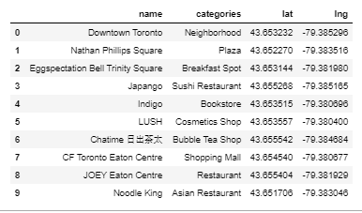
mapping DATA
Toronto venues

Slide 5
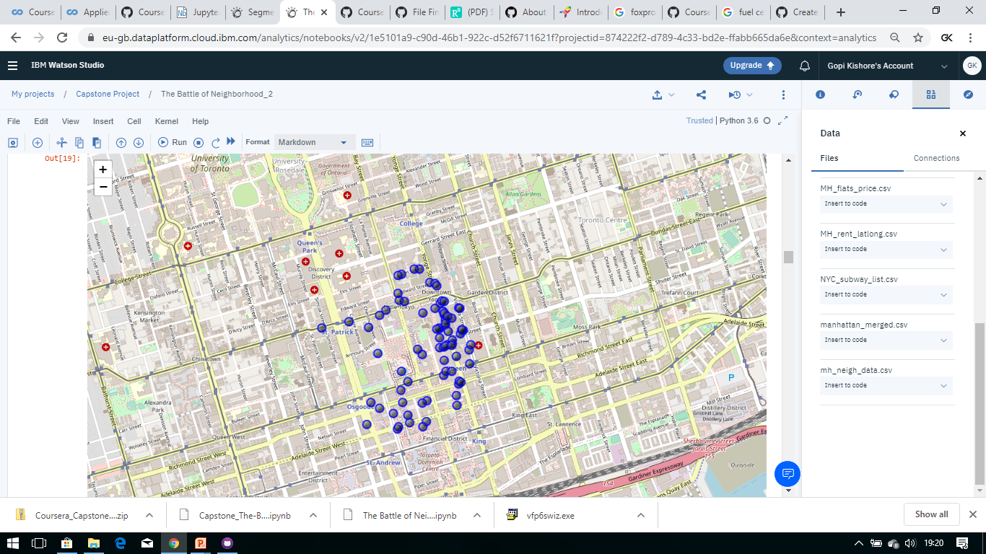
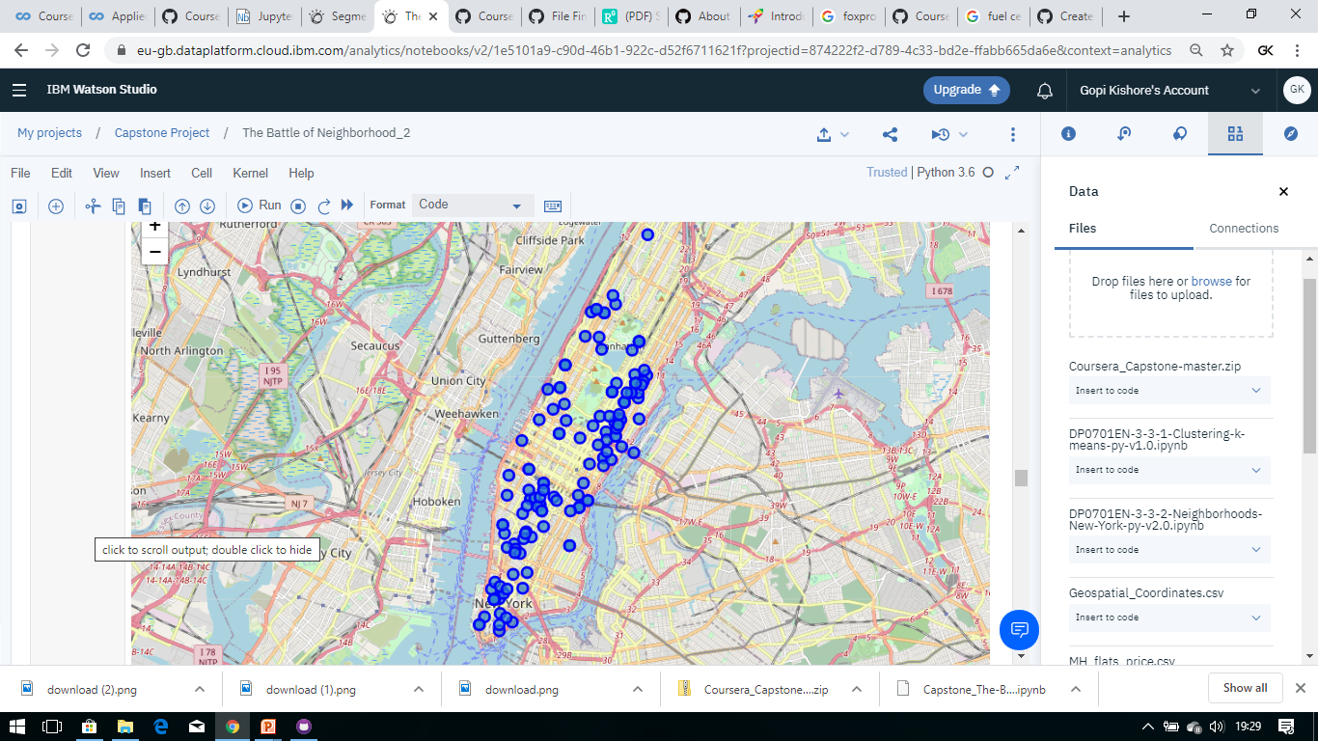
Map of Toronto residence place with venues in Neighborhood - for reference

Slide 6
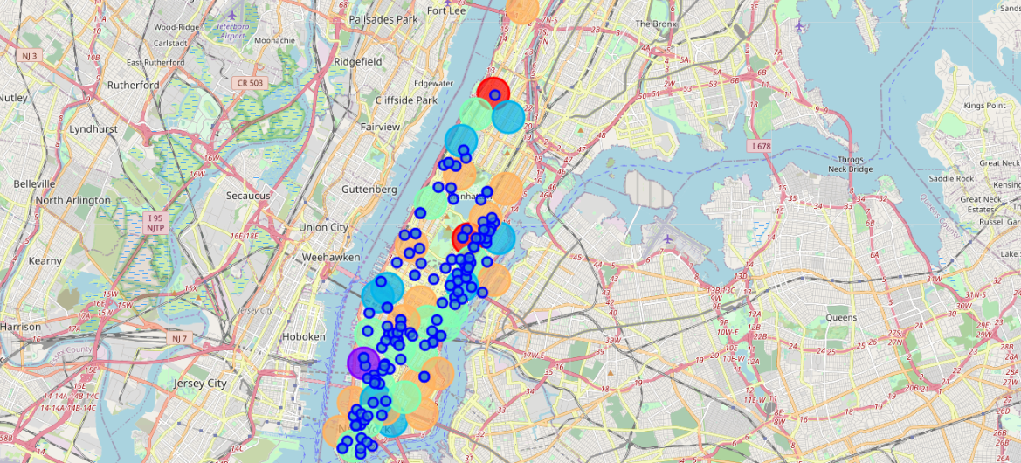
Map of Manhattan showing the places for rent and the cluster of venues

Slide 7
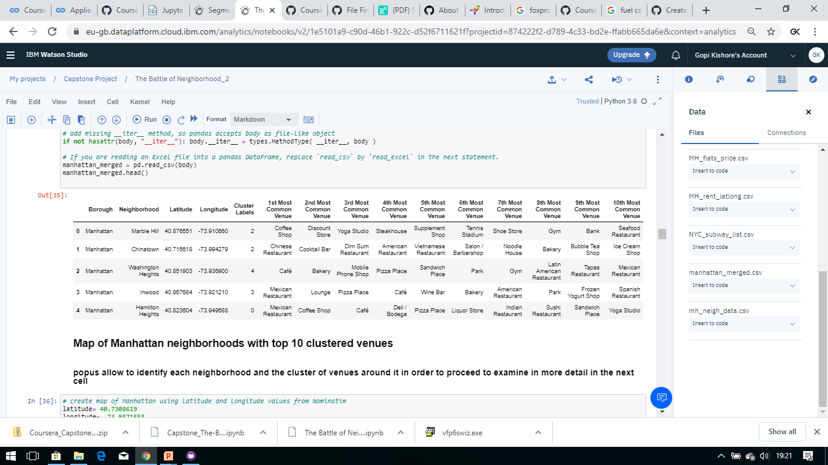
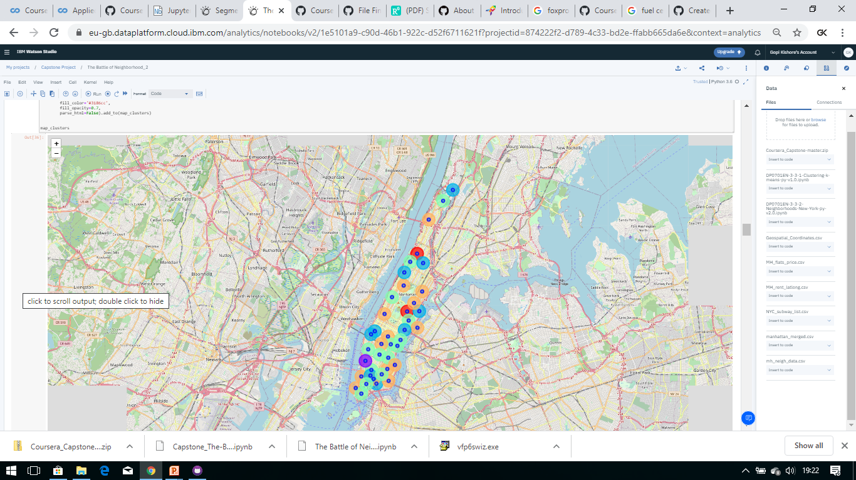
MANHATTAN NEIGHBORHOODS - DATA AND MAPPING

Slide 8
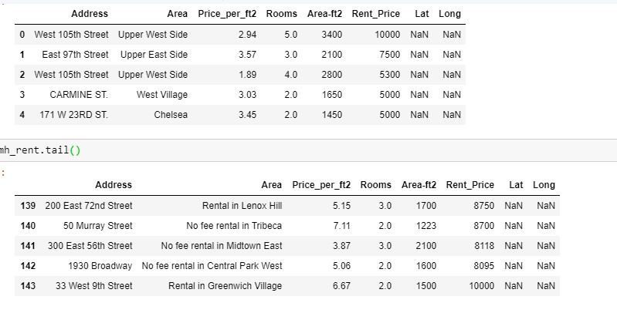
Map of manhattan places for rent

Slide 9
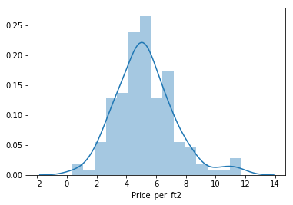
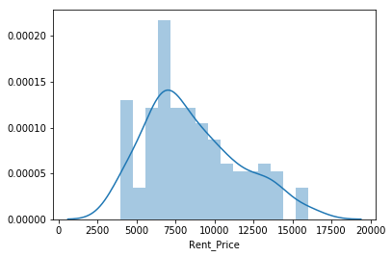
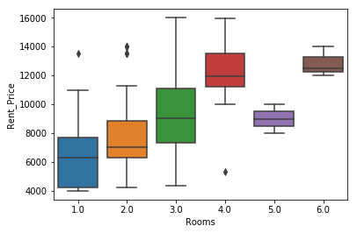
Manhattan

Slide 10
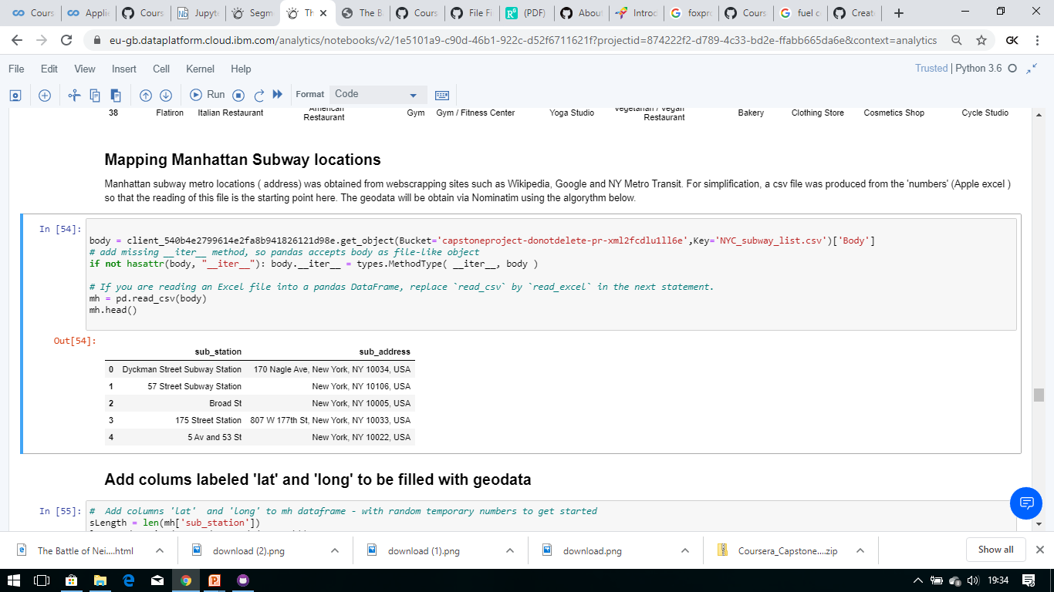
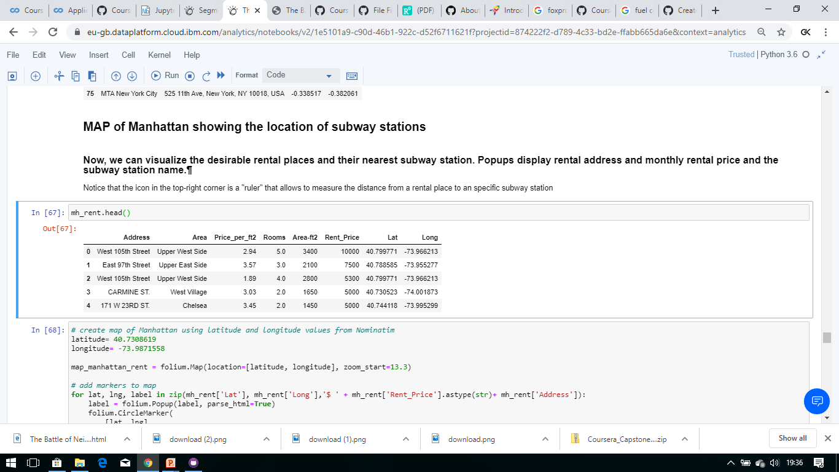
Mapping Manhattan Subway locations
MAP of Manhattan showing the location of subway stations

Slide 11
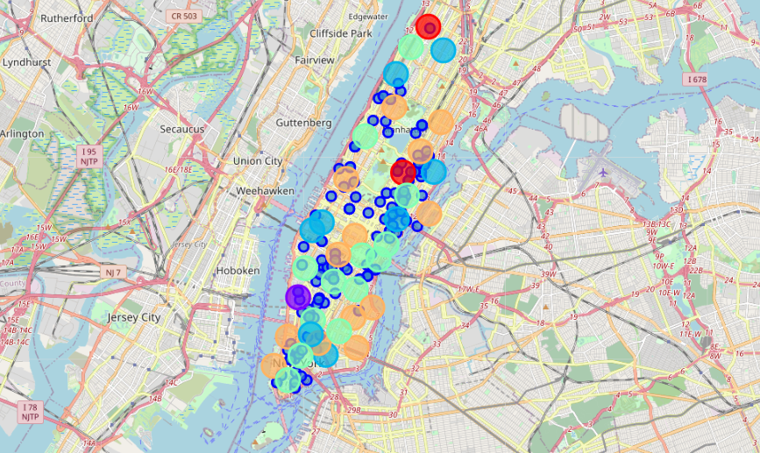
ONE CONSOLIDATE MAP
Red dots are Subway stations,
Blue dots are apartments available for rent,
Bubbles are the clusters of venues

Slide 12
Problem Resolution - Select the apartment for rent
The above consolidate map was used to explore options. After examining, I have chosen two locations that meet the requirements which will assess to make a choice.
Apartment 1: 305 East 63rd Street in the Sutton Place Neighborhood and near 'subway 59th Street' station, Cluster # 2 Monthly rent : 7500 Dollars.
Apartment 2: 19 Dutch Street in the Financial District Neighborhood and near 'Fulton Street Subway' station, Cluster # 3 Monthly rent : 6935 Dollars

Slide 13
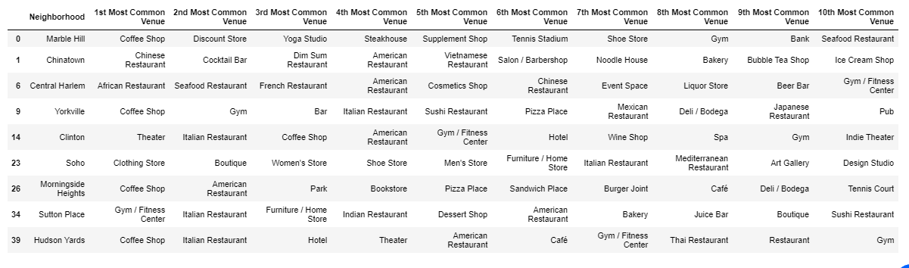
Venues for Apartment 1 - Cluster 2

Slide 14
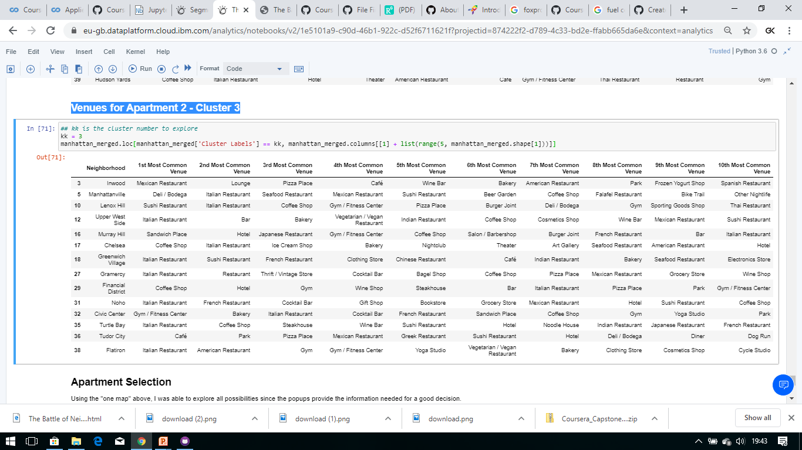
Venues for Apartment 2 - Cluster 3

Slide 15
Apartment Selection
Apartment 1:
Rent cost : US7500 slightly above the US7000 budget.
Located : 400 meters from subway station at 59th Street
Work place ( Park Ave and 53rd) : 600 meters way.
Subway : for other places around.
Venues : East side of Manhattan.
Apartment 2
Rent cost : US6935, just under the US7000 budget.
Located : 60 meters from subway station at Fulton Street,
Note: Have to ride the subway daily to work, possibly 40-60 min ride.
Venues : Cluster 3.

